Slide 1


Slide 2


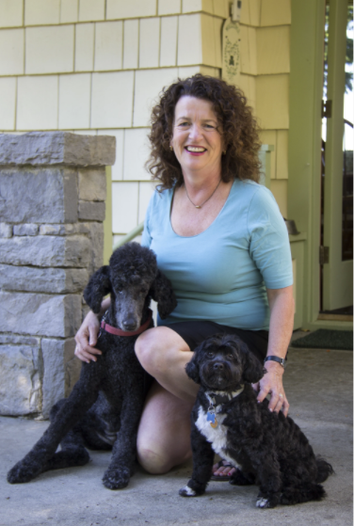


It all started with a dog named Rosie… And the Determination of her Beloved Companion
Rosie had fallen ill and lost her appetite
In 2014, Katie McCarron’s 14-year-old poodle lost her appetite and her health declined. Katie sought help but was told that this was just Rosie’s time. Determined to find something healthy that Rosie would love, Katie put her background in nutrition to work and began cooking meals in her own kitchen.
Katie’s cooking with high quality ingredients works
She used locally-sourced natural ingredients, and Rosie loved it. She regained her appetite and lived until she was almost 17! And just like that, Portland Pet Food Company was born.
Now, PPFC products are used for happier healthier dogs
PPFC helps dogs thrive with the same nutritious meals and treats that were formulated in Katie’s kitchen years ago. We never compromise on quality, focusing on fresh, local ingredients with a commitment to sustainability.

Slide 3
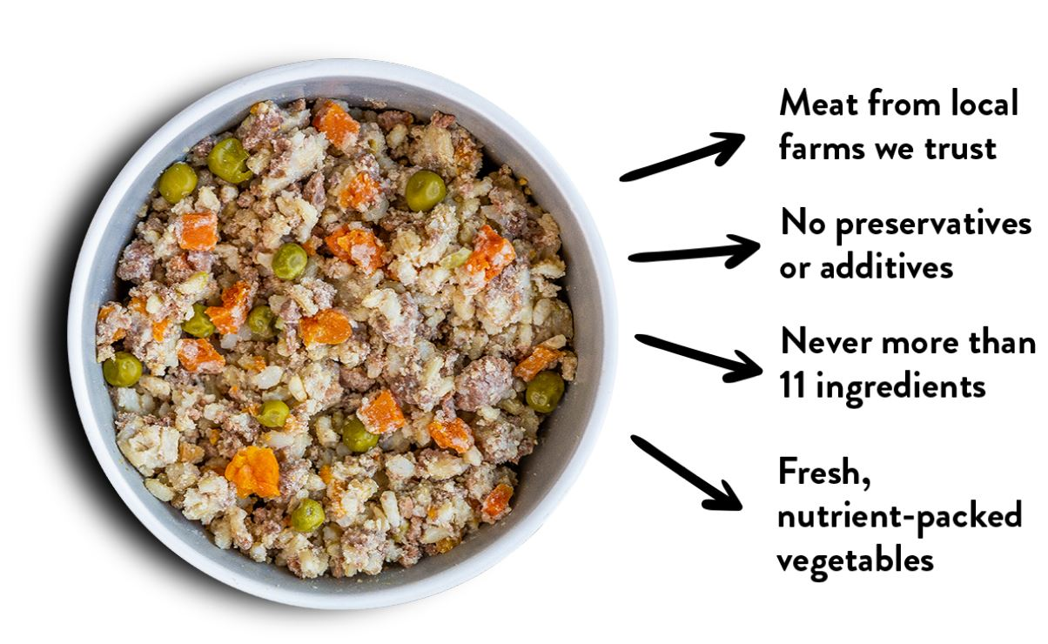
Uncompromising Quality Experience the Difference
Our meals are the first of their kind, pre-cooked meals in a ready-to-serve pouch, with only human-grade ingredients. Great for picky dogs, elder dogs or dogs leading a busy lifestyle.
All Ingredients are sourced from the USA – primarily in the Pacific Northwest. Meats are human grade and produce is fresh or IQF depending upon the season.
We bring high quality human food to dogs - no rendered meats or supplements.
Our production facilities are approved for human food production. We are approved by APHIS for export to several countries and adhere to good food manufacturing practices.

Slide 4









People Have Taken Notice Details and Accreditations
What grew out of a necessity in 2014, the Portland Pet Food Company brand is now sold throughout the USA, Canada…. as well as Globally.
We are members of the Specialty Food Association, American Pet Product Association, World Pet Association and membership as the only pet food in the Good Food Guild.
All packaging is BPA Free, and Portland Pet Food Company is a member of TerraCycle.
Recognized as one of the top 20 pet food companies by the Pet Sustainability Coalition
A certified women owned business through WBENC
Quality & Accreditations
Committed to Sustainability

Slide 5
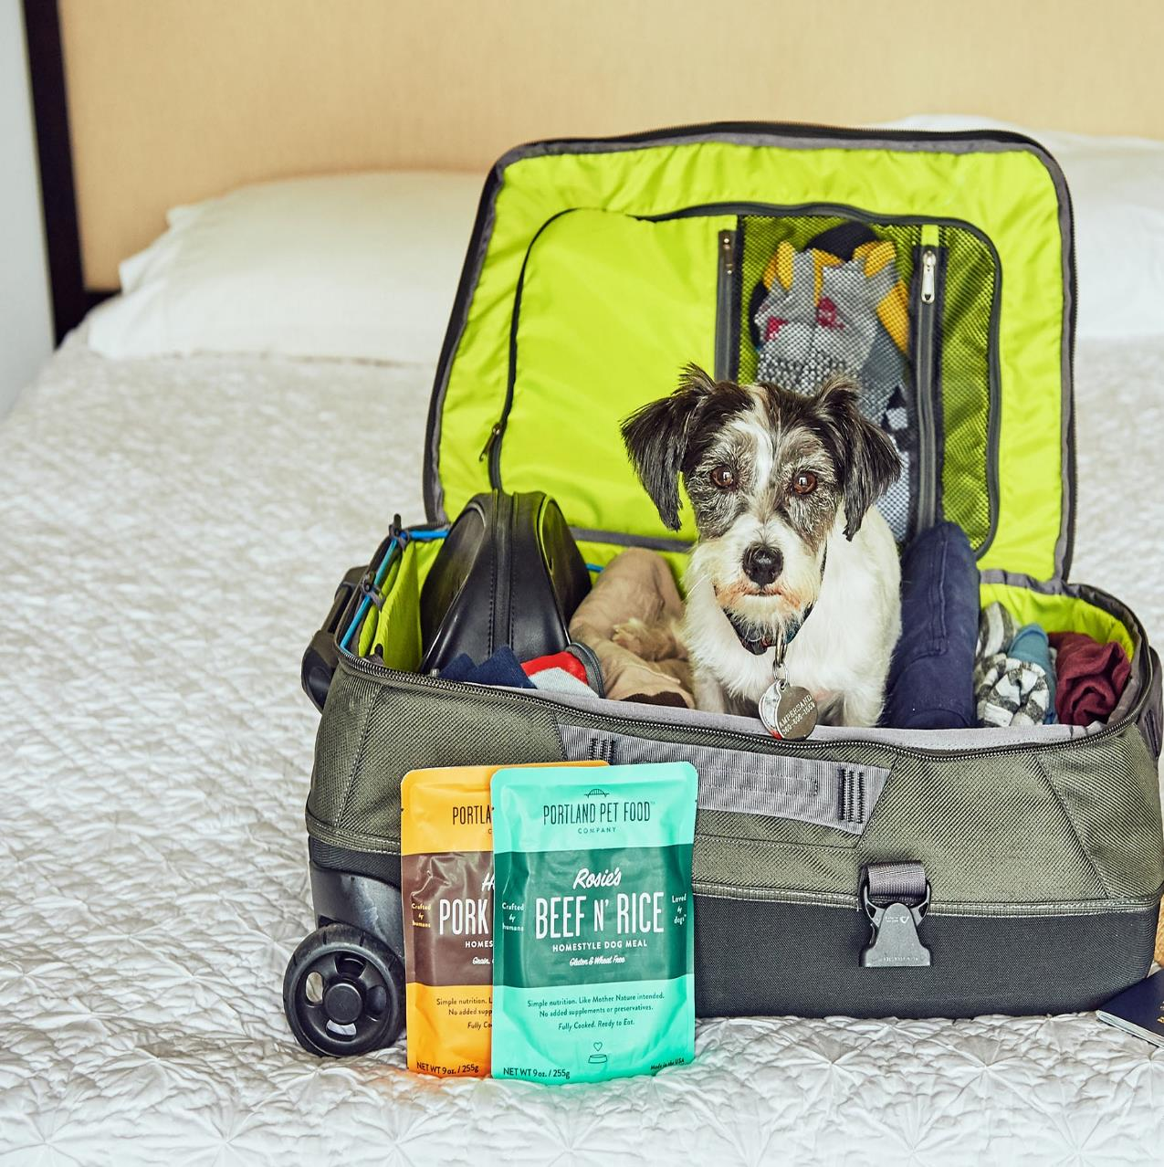

Homestyle Dog Meals
At home or on the go!

Slide 6
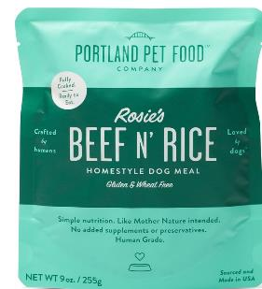
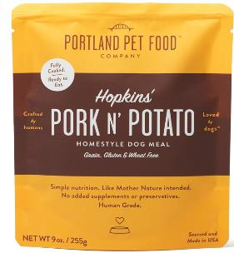
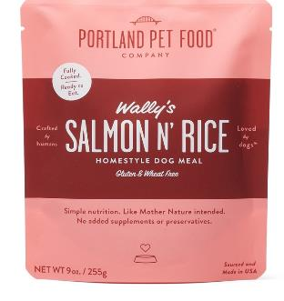
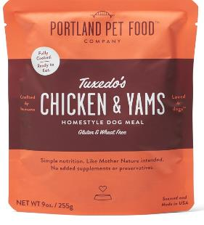
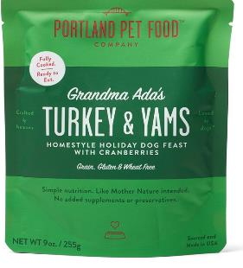
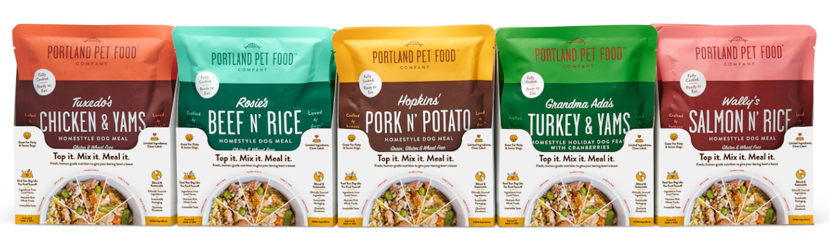
Homestyle Dog Meals
Fresh, Human-Grade Options
Five Formulas for supplemental feeding. Topper, mixer, or rotational meals.
  Rosie’s Beef N’ Rice - Gluten Free & Wheat Free
  Wally’s Salmon N’ Rice – Gluten Free & Wheat Free
  Tuxedo’s Chicken & Yams - Gluten Free & Wheat Free
  Hopkins’ Pork N’ Potato – Grain Free & Gluten Free
  Grandma Ada’s Turkey & Yams - Grain Free & Gluten Free
Limited Ingredients (9-11 ingredients per formula)
No Additives, Preservatives or Artificial Flavorings
Unique Packaging, Easy to Serve, BPA Free
2-Year Shelf Life
Highly Palatable - perfect for finicky eaters & elderly dogs
9 oz. Stand Up Pouches/8 per case
SRP - $5.99
Made & Sourced in the USA
Shelf Ready Display Case

Slide 7
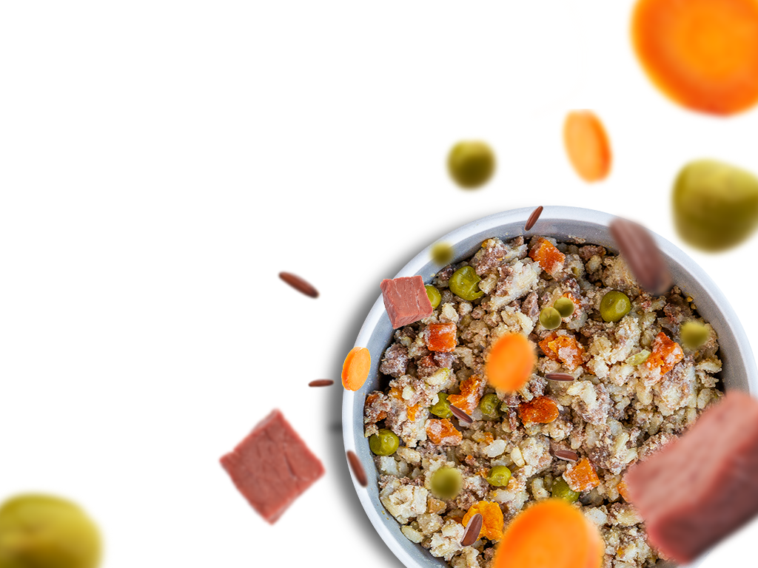
Multiple Ways to Serve
Top it, Mix it, Meal it!
Can be used as a great complement to kibble
Great, natural “boost” to a standard bowl
Gently-cooked to maximize taste and nutrient density
No meal contains more than 11 natural ingredients
All ingredients are ethically sourced and made in the USA
*Photos of actual product directly from pouch*

Slide 8
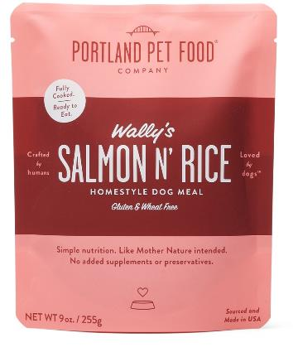

“Newest” Homestyle Dog Meal
Wally’s Salmon N’ Rice
Featuring Wild Caught Northwest Human Grade Sockeye Salmon and all USA ingredients.
Ingredients: Salmon, Carrots, Peas, Brown Rice, Spinach, Eggs, Vegetable Oil, Potato Flour, Eggshells and Sea Salt.
Salmon is the primary ingredient at 69%!
9 oz. Stand Up Pouch/8 per case
SRP - $5.99
Made & Sourced in the USA
Shelf Ready Display Case

Slide 9
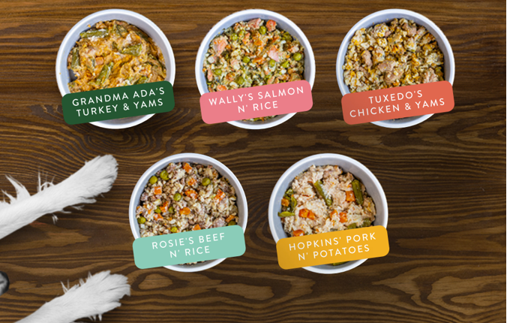
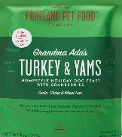

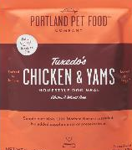
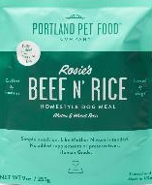
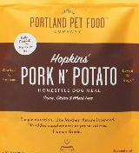
Check Out the Whole Line Up
Made With Real Ingredients You Can Actually See
*Photos of actual product directly from pouch*

Slide 10
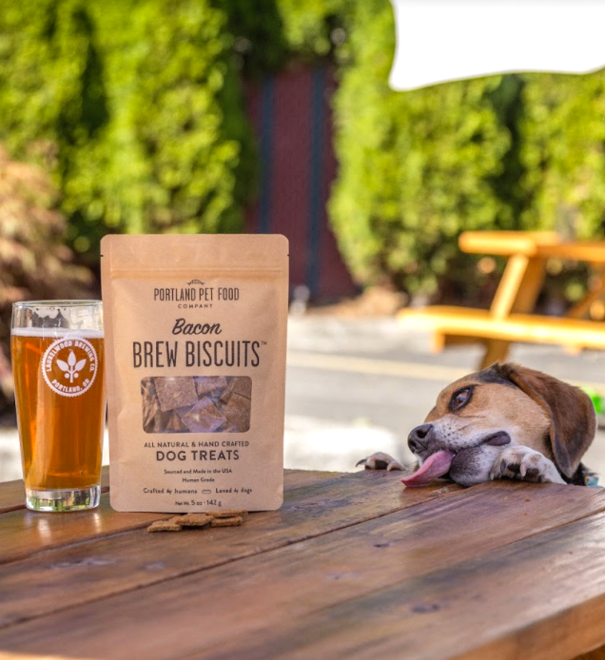

Handcrafted Dog Biscuits

Slide 11

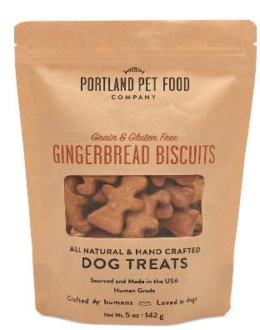

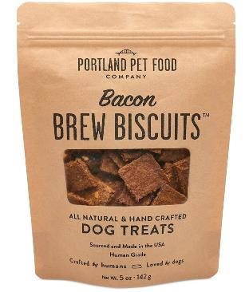
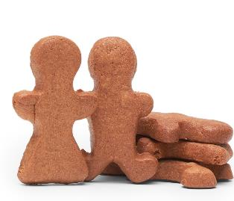
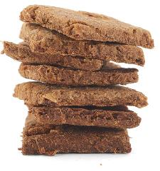
Handcrafted Dog Biscuits
Grain & Gluten Free Biscuits
  Bacon
  Pumpkin
  Gingerbread
Original Biscuits
  Bacon Brew
Limited Ingredients
(4-7 ingredients per formula)
Twice Baked Formulas
Brew Biscuits repurposing spent grains from local Oregon Breweries
Upcycled Ingredients for Eco-Friendly Dog Treats
5 oz. Stand Up Pouches/6 per case
SRP - 9.99
Made & Sourced in the USA

Slide 12
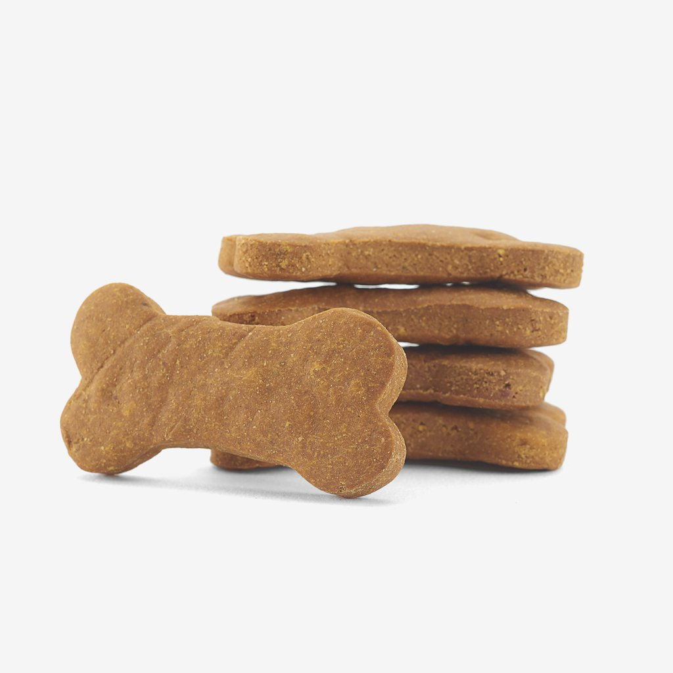
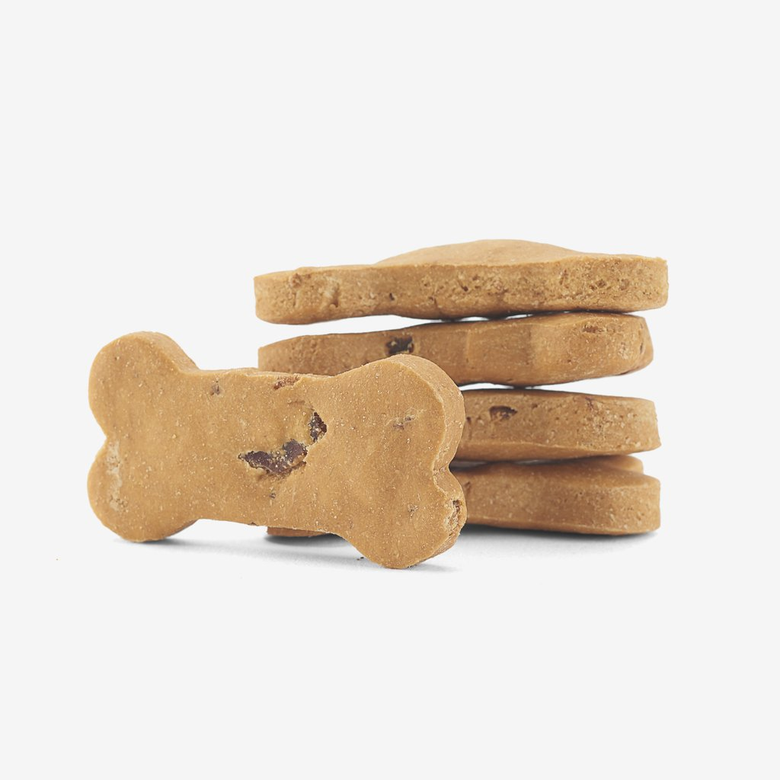
Grain & Gluten Free Dog Biscuits
  Bacon
  Pumpkin
  Gingerbread

Slide 13
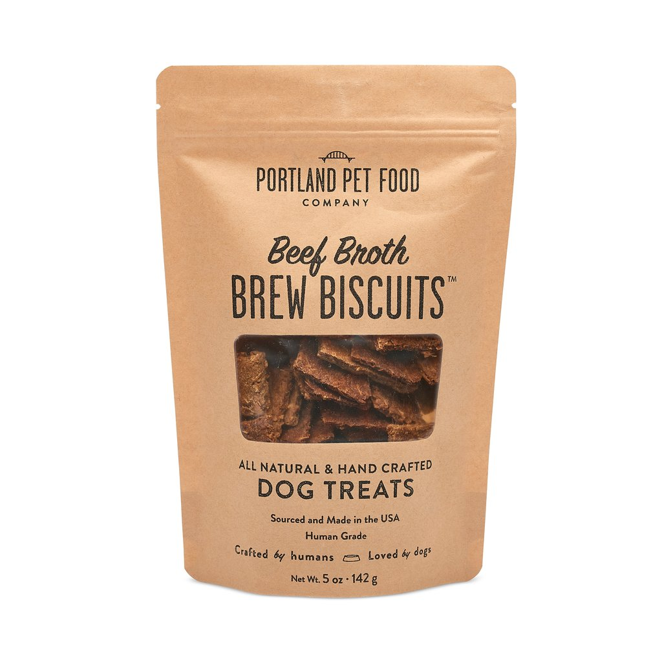
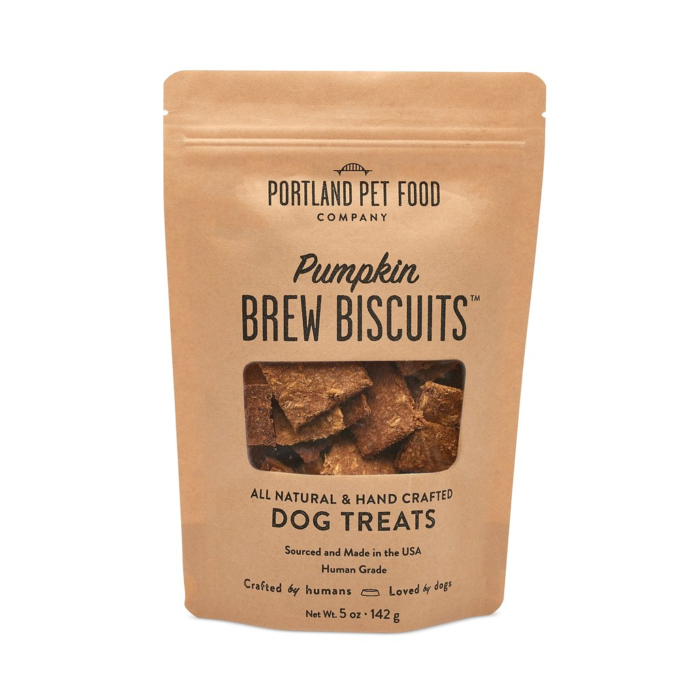
Brew Biscuits & Sustainability
Portland Pet Food’s Sustainability Commitment
  Bacon
  Beef Broth
  Pumpkin
Upcycle spent grains beer & whiskey malt, repurposing 4,350 pounds of spent grains in 2020!
From local breweries in Portland, OR.

Slide 14
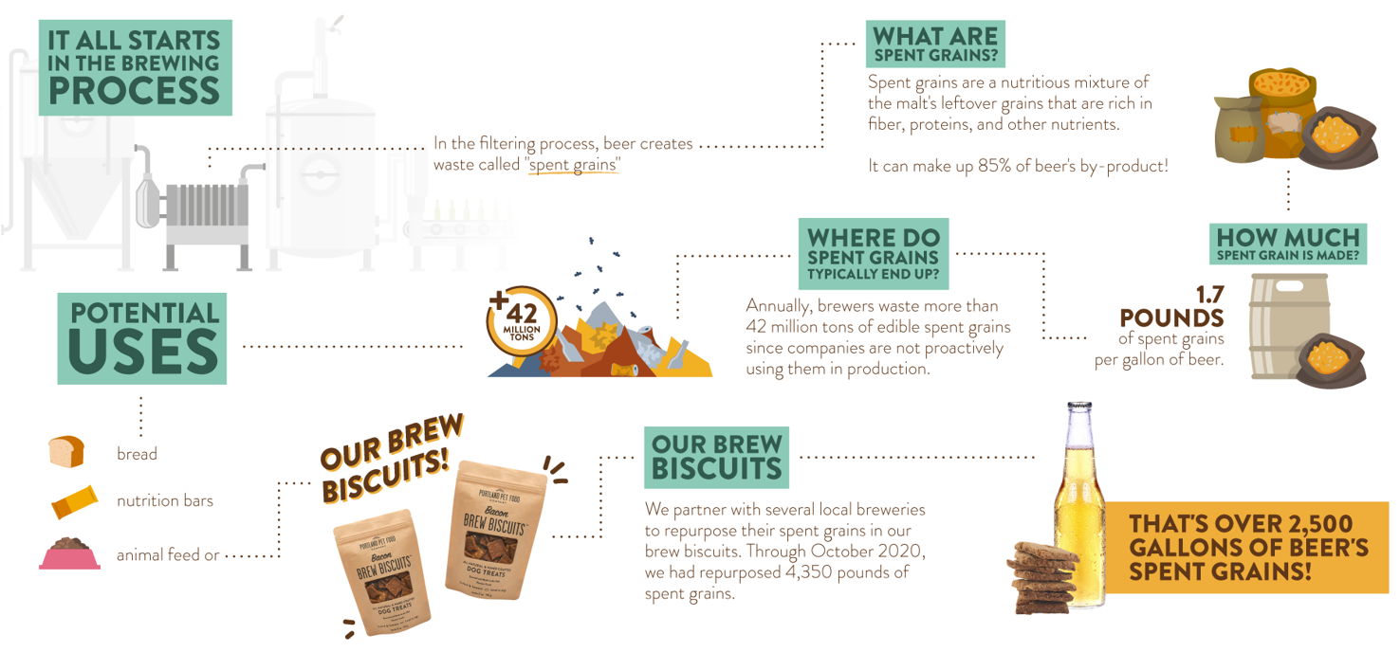
What is a Brew Biscuit??
A nutritious, sustainable way to get as close to sharing a brew with your best bud!
By partnering with local breweries, we upcycle spent grains to generate barley for these biscuits… Here’s how it works:

Slide 15
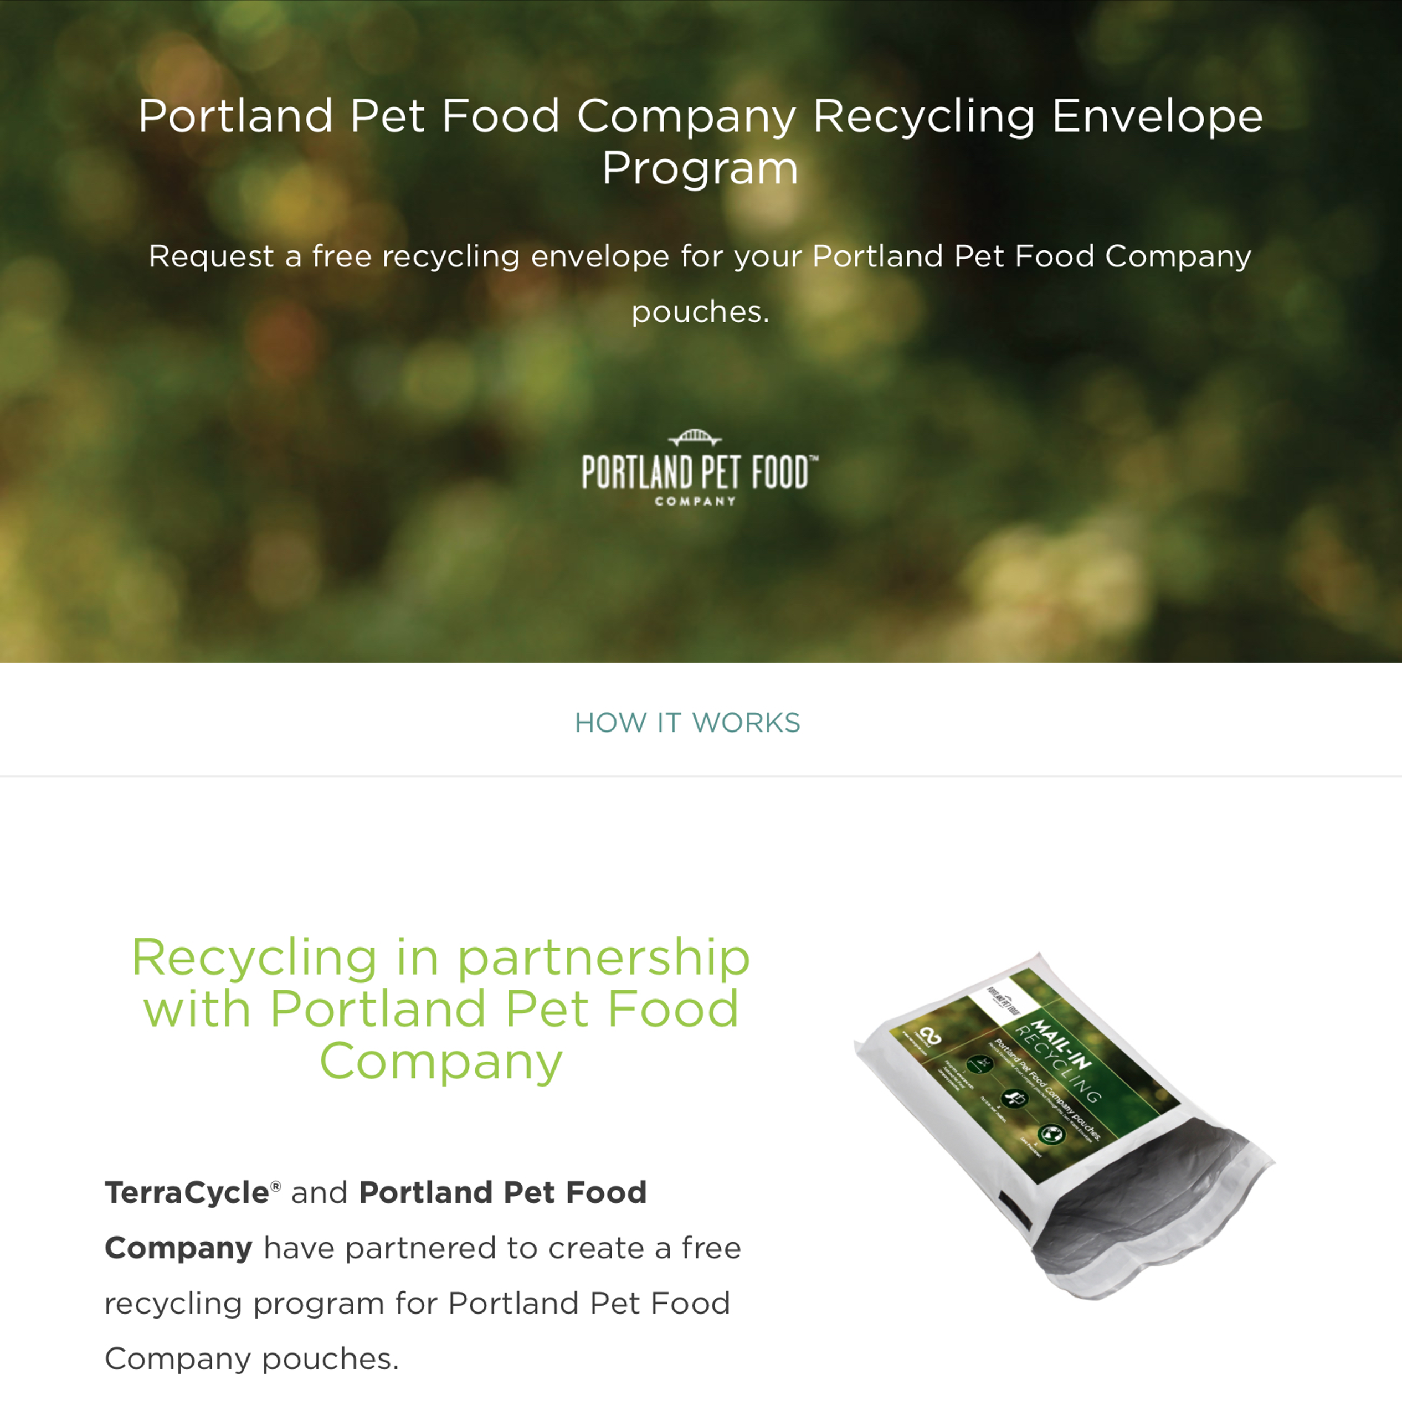
As to TerraCycle, consumers may partner with group for recycling program as to returning bags.
At this time, our packaging is not biodegradable.

Slide 16

Portland Pet Food’s Sustainability Commitment
And people have taken notice
There is room for improvement in sustainability efforts in the pet food industry, with less than 5% of pet food packaging being recyclable. People have been impressed with PPFC’s efforts:
Accredited as a Top-20 Brand by Pet Sustainability Coalition
The only pet food part of the Good Food Guild – an organization with extremely high expectations on sourcing and sustainability
A member of the Upcycled Food Association
And continually looking to improve!

Slide 17
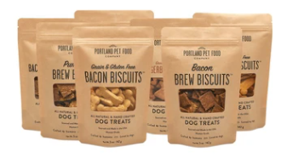
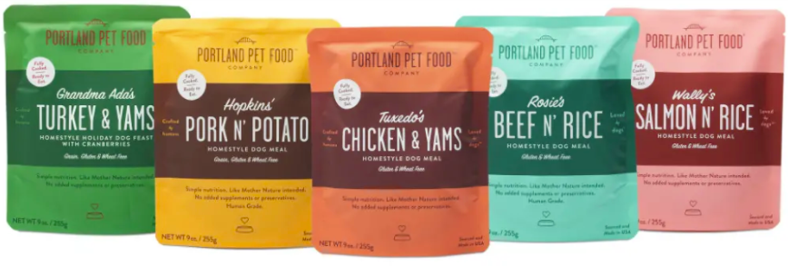


PPFC Loyalty Program @ Indie Pet
BISCUITS STRATEGY
MEALS STRATEGY
In a category known for low cost of switching, we will drive repeat purchase and loyalty by having our biscuits on Astro Loyalty
Program structured as buy 10 get 1 free
We know our meals naturally drive high repeat upon trial so we will utilize Astro Offers to stimulate purchase through $$ off and Buy-Get programs throughout the year
Marketing is working on point of sale that can be included in store to get loud about the new programs. If you have thoughts on best practices, please share.

Slide 18
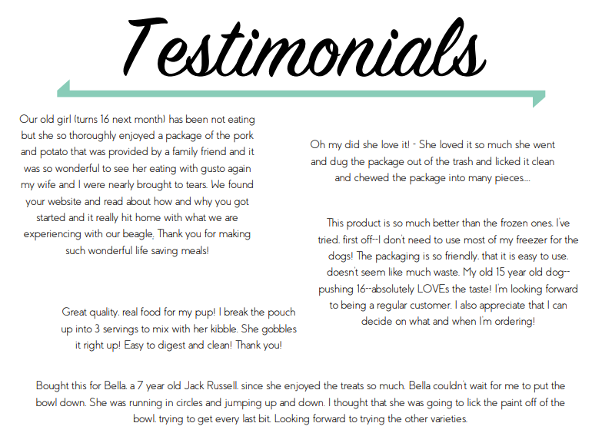
Hear from our customers

Slide 19
